Slide 1
Exception Handling in Java
Prepared by
Mandakini B. Karande

Slide 2
What are Exceptions?
- Definition: An exception is an event that occurs during the execution of a program, disrupting the normal flow.
- Examples: Runtime errors, logical errors, user input errors

Slide 3
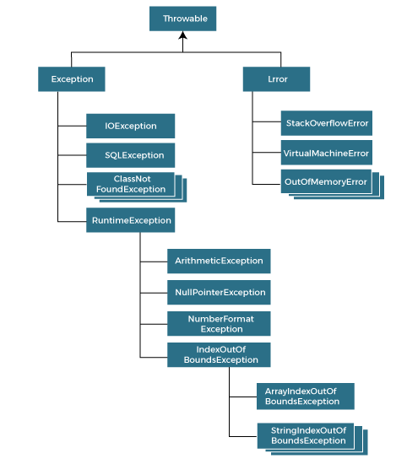
Hierarchy of Java Exception classes

Slide 4
Types of Exceptions
- Checked Exceptions: Predictable, checked at compile-time (e.g., IOException)
- Unchecked Exceptions: Unpredictable, not checked at compile-time (e.g., NullPointerException)
- Errors: Critical, irrecoverable (e.g., OutOfMemoryError)

Slide 5
Exception Handling Mechanisms
- Try-Catch Block: Enclose code that might throw an exception
- Throw: Explicitly throw an exception
- Throws: The "throws" keyword is used to declare exceptions. It specifies that there may occur an exception in the method.
- The "try" keyword is used to specify a block where we should place an exception code. It means we can't use try block alone. The try block must be followed by either catch or finally.
-The "catch" block is used to handle the exception. It must be preceded by try block which means we can't use catch block alone. It can be followed by finally block later.

Slide 6
Try-Catch Block
- Syntax:
try {
// Code that might throw an exception
} catch (ExceptionType e) {
// Handle the exception
}

Slide 7
Catching Multiple Exceptions
- Syntax:
try {
// Code that might throw an exception
} catch (ExceptionType1 e) {
// Handle Exception Type 1
} catch (ExceptionType2 e) {
// Handle ExceptionType2
}

Slide 8
Finally Block
-The "finally" block is used to execute the necessary code of the program. It is executed whether an exception is handled or not.
- Syntax:
try {
// Code that might throw an exception
} catch (ExceptionType e) {
// Handle the exception
} finally {
// Code that always executes
}

Slide 9
Conclusion
- Exception handling is crucial for robust code
- Understand exception types and handling mechanisms

Slide 10
Thank you…

